Slide 1
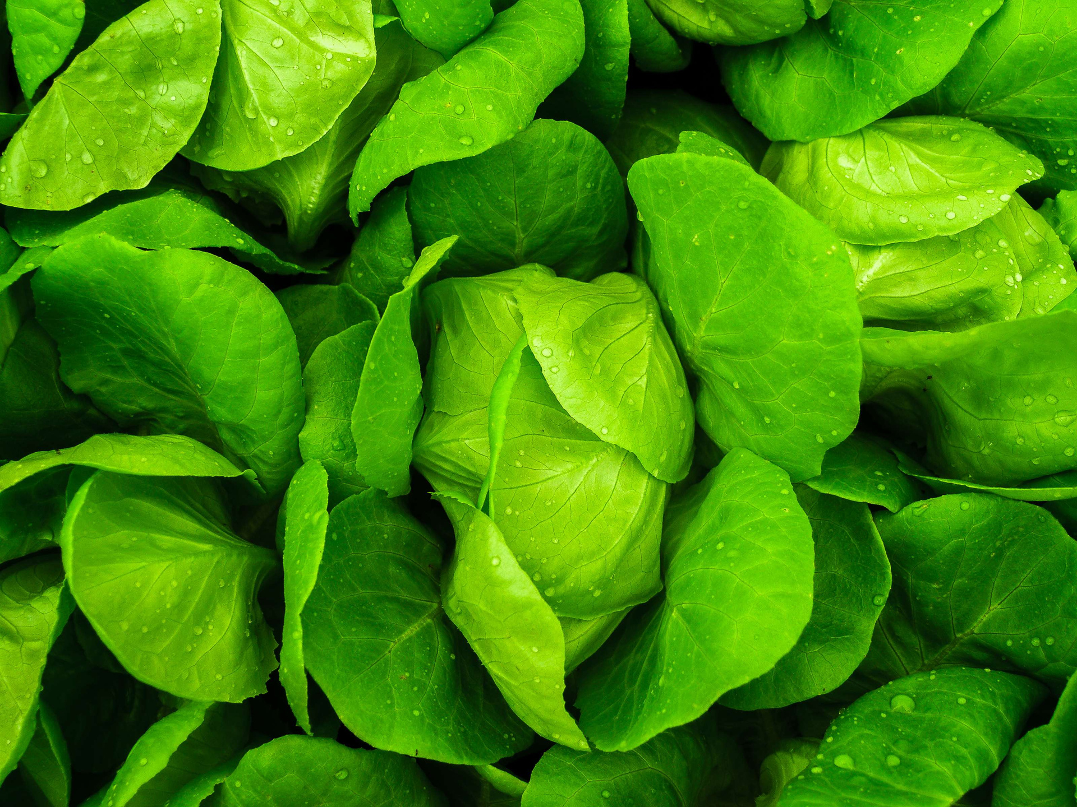

Ginyard International Co.
Home
Project
About Us
Contact
Empowering the Future of
Agriculture through Artificial
Intelligence
TEAM NAME:- AGRI-VISION
T.GANESH -25H55A0544
B.RISHIKA SRI -24H51A05HH
A.VASAVI -24H51A05P9
Y.AJAY KUMAR -24H51A05P6

Slide 2

PROBLEM STATEMENT
Many farmers still depend on traditional methods and personal experience, leading
unsuitable crop choices and low productivity. Limited access to timely information also delays disease detection, causing crop damage and financial loss.
Farmers often choose crops without real-time guidance, resulting in poor yields and higher risks. Late identification of crop diseases further harms production and reduces income.

Slide 3
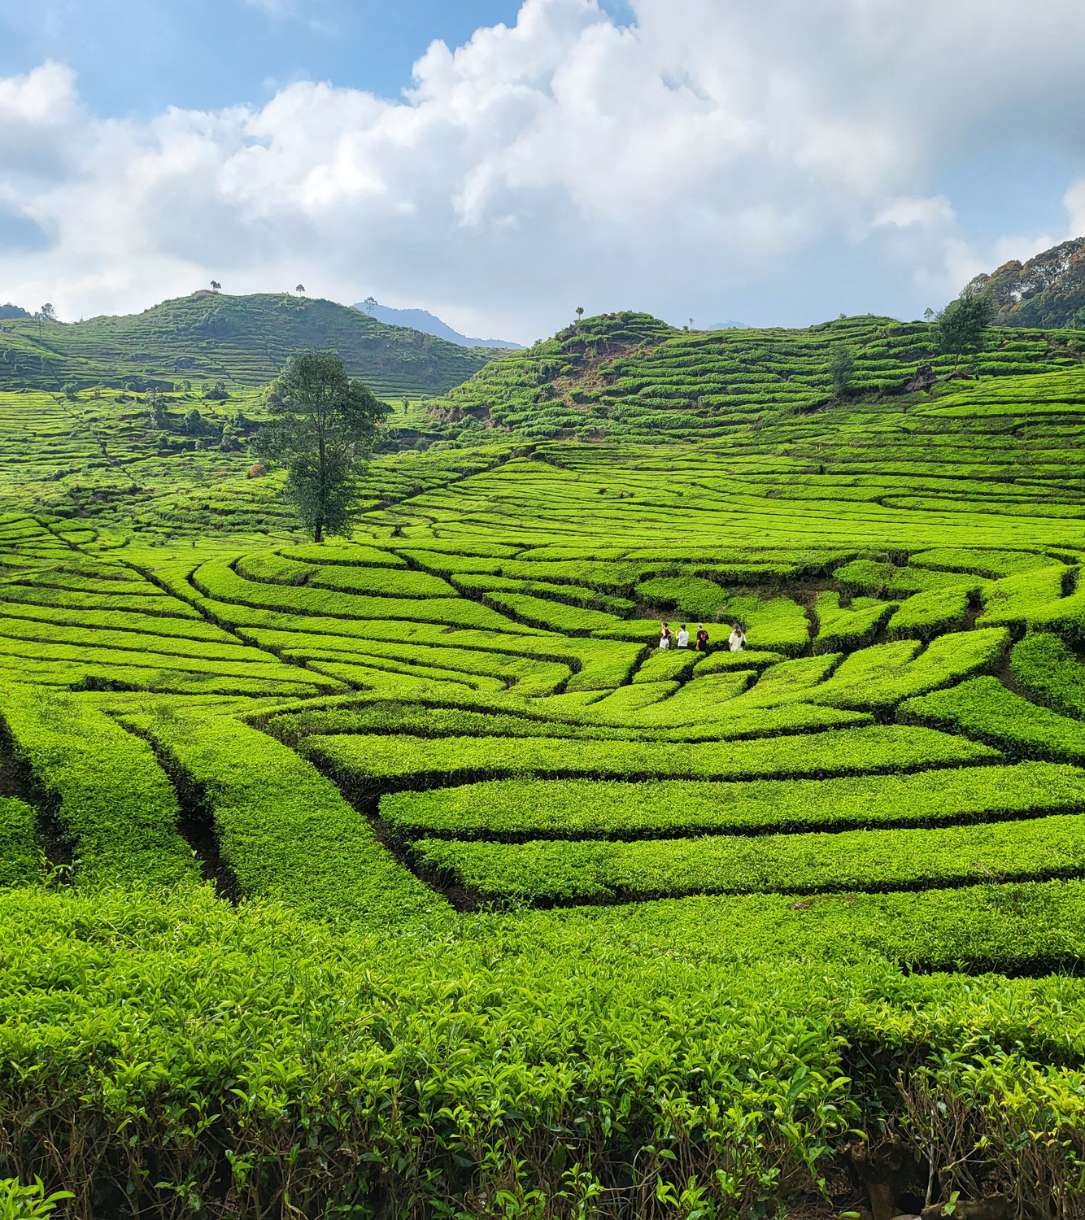
Existing System
Farmers rely on visual experience or local "experts" for disease diagnosis.
Information seeking requires physical visits to government offices or fertilizer shops.
Contracting for tractors or labour is done through
word-of-mouth with no price transparency.
Recommendations for crop rotation are often based on habit rather than data.

Slide 4
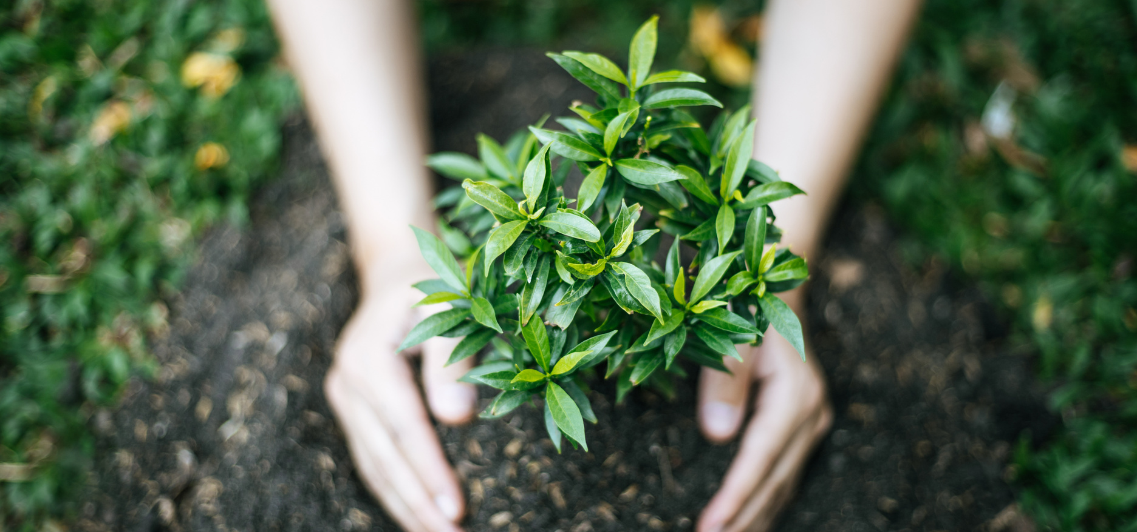
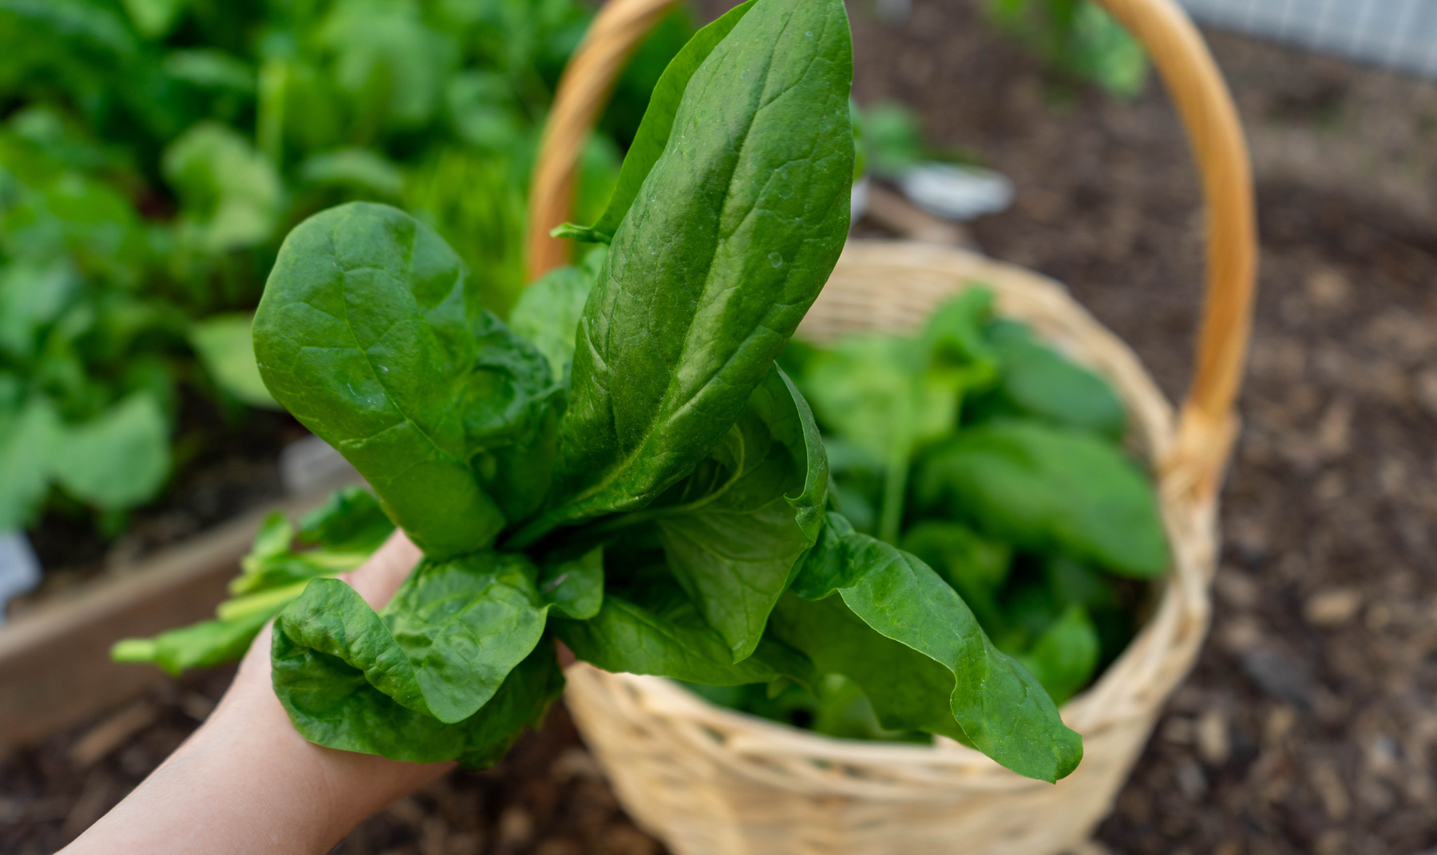
Drawbacks of Existing System
Slow Response: By the time a disease is identified,
it has often spread to the entire field.
Economic Loss: Overspending on incorrect
pesticides due to wrong diagnosis.
Limited Reach: Paper-driven systems exclude
farmers who cannot travel or read complex documents.

Slide 5
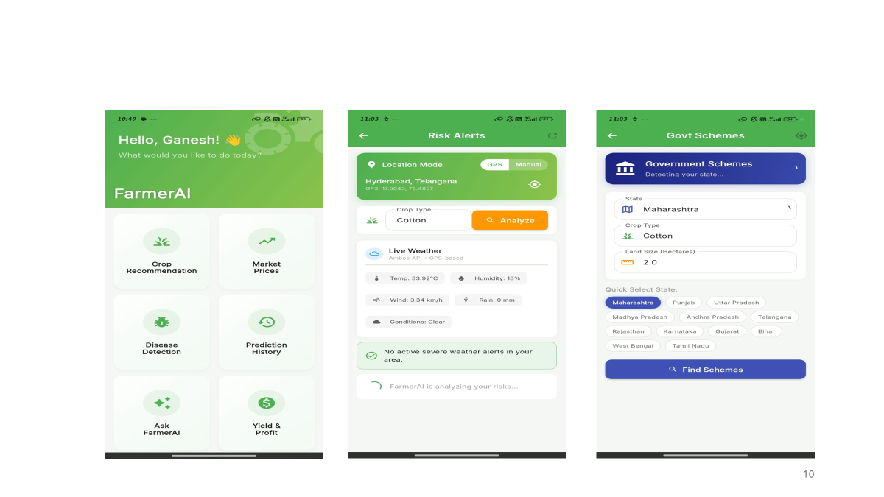
Proposed System (Farmer AI)
Ginyard International Co.
Home
Project
About Us
Multi-lingual Interface: Full support for Telugu, Hindi, and English.
AI Disease Detection: Real-time diagnosis using a phone camera and Deep Learning.
Smart Recommendations: AI-driven advice for crops, schemes, and rotation based on soil and season.
Service Marketplace: A digital platform to hire machinery and labour with an integrated AI Negotiation Tool
Risk Alert System: An alerting system which alerts the farmer for climate changes.
Govt Shemes also included.

Slide 6
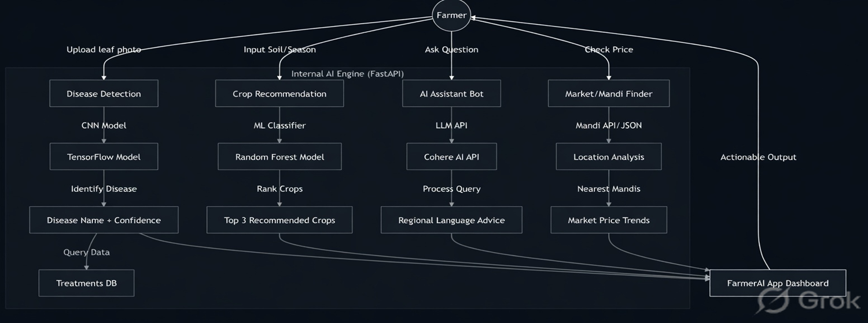
FLOW CHART

Slide 7
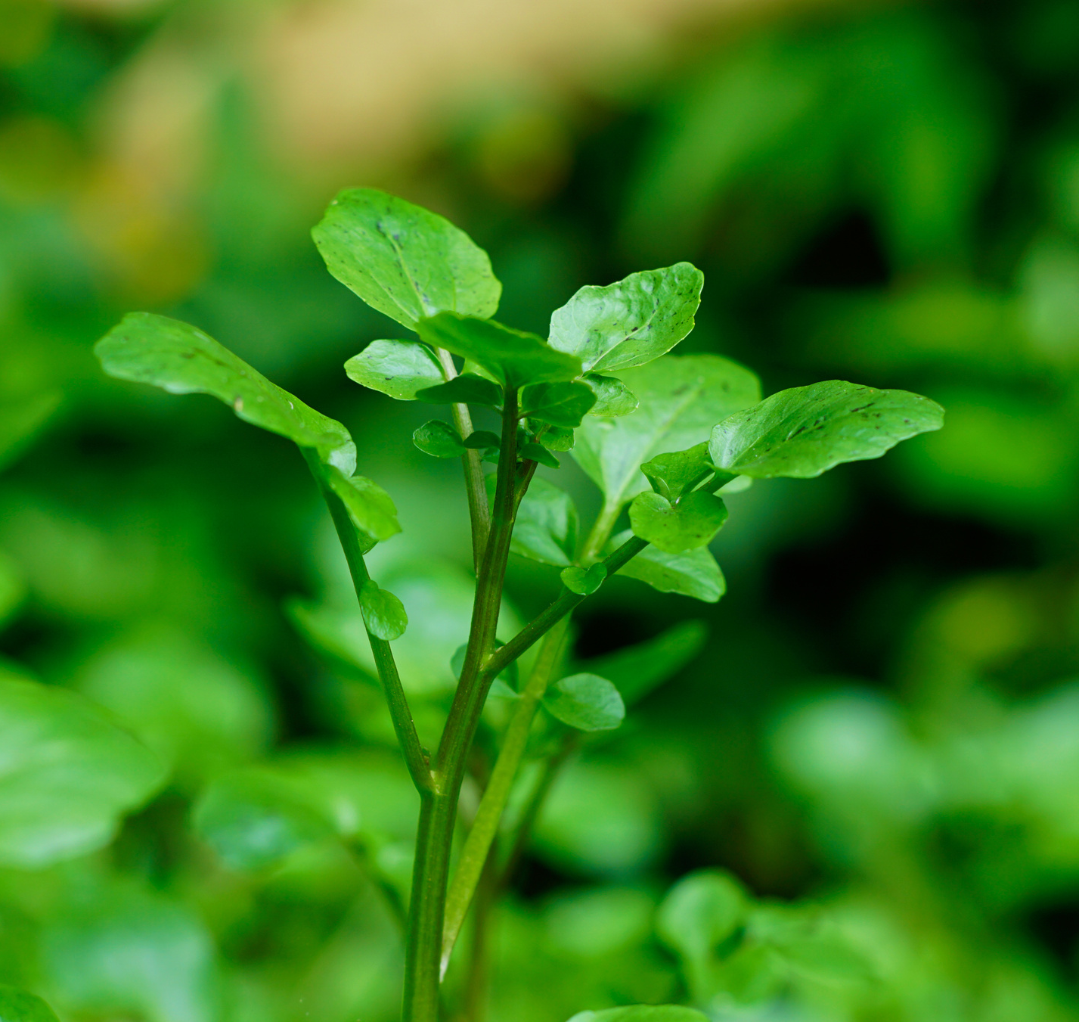
Technologies Used
Frontend: Flutter (for a premium, cross-platform
mobile experience).
Backend: FastAPI (Python) - High-performance
engine for AI processing.
AI/ML:
TensorFlow: For image-based plant disease detection.
Cohere API: Large Language Model (LLM) for personalized
farming advice and negotiation.
Database: SQLAlchemy with SQLite for efficient
data management.

Slide 8
Conclusion
Impact:
Reduces harvest loss via early detection.
Increases income through informed crop selection and fair market negotiation.
Democratizes technology for rural farmers.
Future Roadmap: Integration with IoT soil sensors and real-time weather analytics for even more precision.

